Slide 1

Web Development Foundations
05
DOM Manipulation & Browser APIs

Slide 2
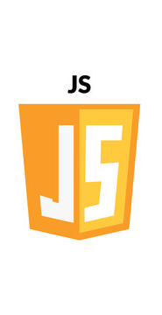
MCQ #2
The Browser Console
Variables
const vs let
Primitive Data Types
Strings, Numbers, Booleans
Complex Data Types
Arrays and Objects
Demo: Create a profile object for a user.
Mini-Challenge: "Create an array of your three favorite movies and log the second movie to the console."

Slide 3
MCQ #2
Graded Quiz covering contents from Session 04
Notes:
Part 1: Assessment & Review (40 Minutes)
MCQ #1 (20m): Conduct the first graded Knowledge Check (covering HTML Semantics and Accessibility).
Assignment Review (20m): Review common pitfalls from the "Hello World" enhancements.
Common Bug: Forgetting to link the CSS file in the <head>.
Common Bug: Labels not properly linked to Input IDs.

Slide 4
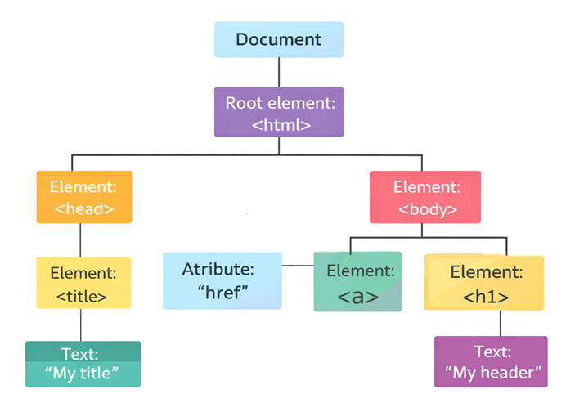
Part 1: The DOM Tree
Document Object Model
How the browser sees the HTML as a hierarchical tree
https://www.w3schools.com/js/js_htmldom.asp

Slide 5
Window and Document Objects
Window object
Represents the browser window
Global Object in browser-based JavaScript
Top level Object
Global variables become properties of window
Document object
Is a property of the window (window.document)
Represents the actual HTML page loaded inside that window
Controls tabs, pop-ups, scrollbars
Global methods
alert(), fetch(), setTimeout()
Storage
localStorage, sessionStorage
Content Selection
querySelector(), getElementById() etc
Content Manipulation
Change text, color, or adding new elements
Event Handling
Listen for clicks, form submissions, keypresses

Slide 6
Demo
DOM
https://codepen.io/magnetik-works/pen/bNeqzXO

Slide 7
Interactive Activity #1
Console Hijack
Task:Open any website that you like, open the console and make changes using the DOM
Example: use `document.querySelector(‘..’).style.display = ‘none’`

Slide 8
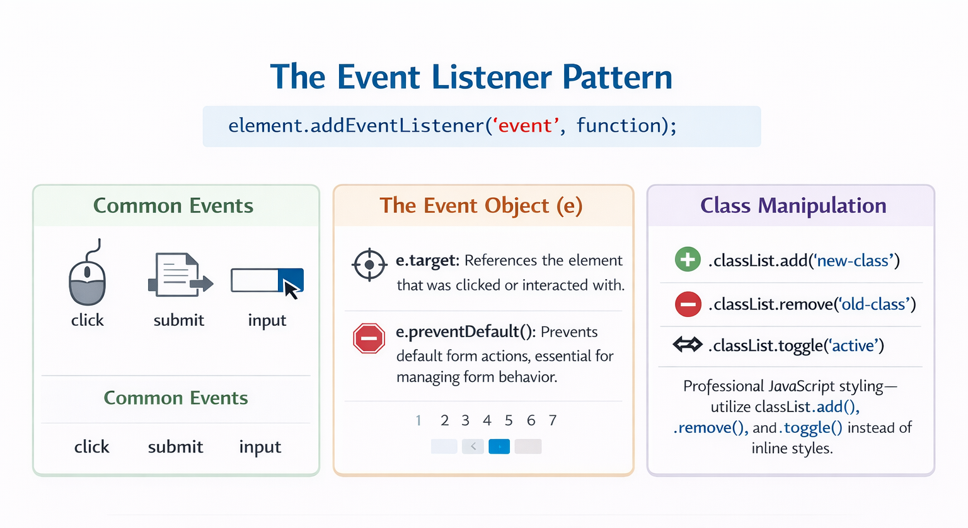
Part 2: Adding Interactivity
Notes:
60 Minutes

Slide 9
Live Demo
Build a “Dark Mode Toggle”
Notes:
Create a button.
Write a JS function that toggles a .dark-theme class on the <body>.
Show how CSS handles the visual change while JS handles the logic.

Slide 10
10
Minute Break

Slide 11
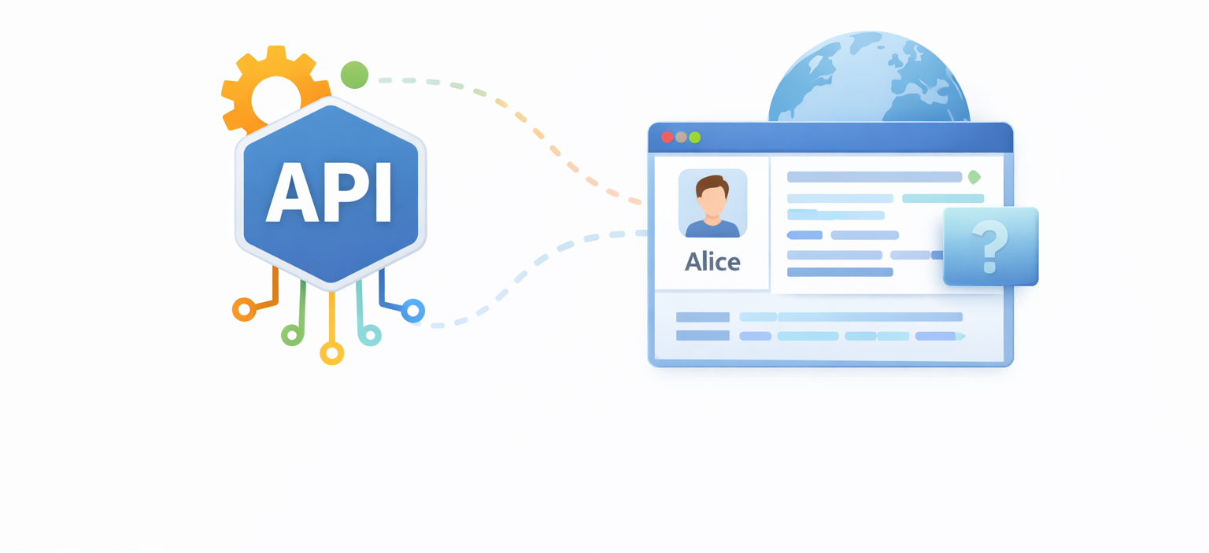
Part 3: Dynamic Content & APIs
Notes:
“Flat Educational Infographic Style with clean UI diagrams”

Slide 12
Dynamic Content
const name = "Alice";
const age = 24;
const course = "UI Design";
// Create HTML using template literal
const studentCard = `
<div class="card">
<h3>${name}</h3>
<p>Age: ${age}</p>
<p>Course: ${course}</p>
</div>
`;
// Insert into the page
document.getElementById("container").innerHTML = studentCard;
Creating Elements
Creating on the Fly: document.createElement() and appendChild().
The Template Literal: Using backticks (`) to inject HTML variables.

Slide 13
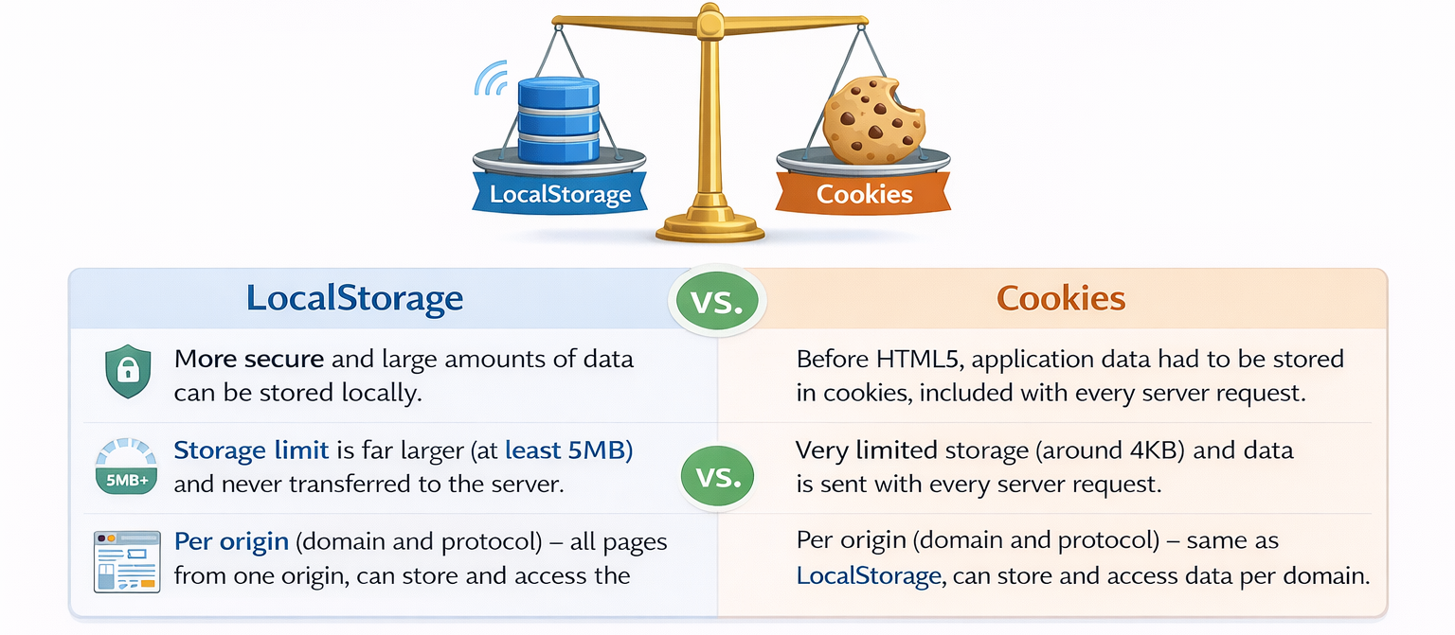
WebStorage API
window.localStorage
stores data with no expiration date (data is not lost when the browser tab is closed)
window.sessionStorage
stores data for one session (data is lost when the browser tab is closed)

Slide 14
Fetch API
The Fetch API provides an interface for fetching resources (including across the network).
In-Depth details in next session

Slide 15
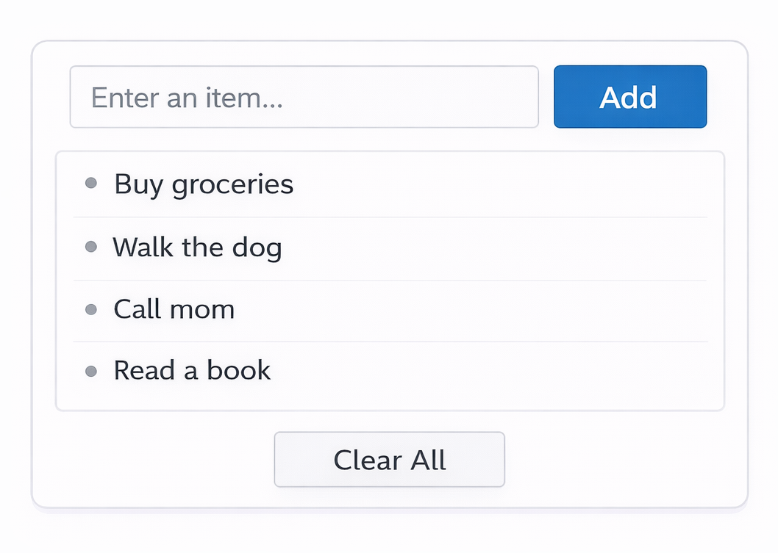
Lab #1
Task List
Implement a Dynamic Task List
Selection: Select a text input and a "Add" button from the DOM.
Creation: When the button is clicked, create a new <li> element.
Injection: Set the text of that <li> to the value of the input and append it to a <ul>.
Interaction: Add a "Clear All" button that removes all items from the list.

Slide 16
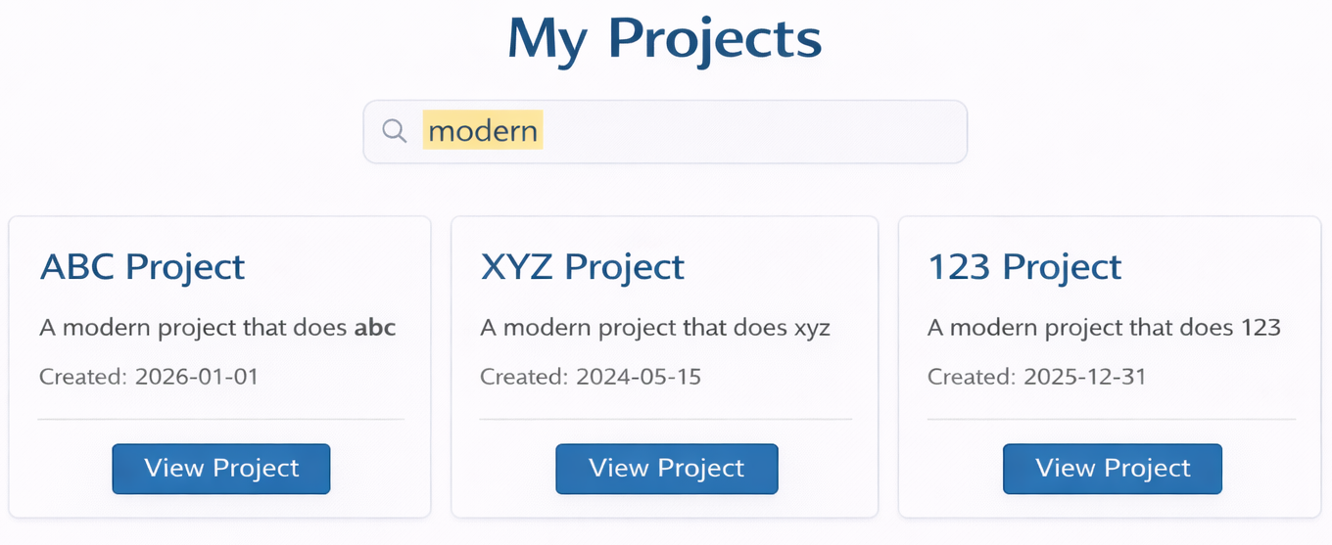
Assignment #2 Dynamic Data
Due Session 6
Goal: Transform your static CSS components into a Data-Driven Application. You aren't just styling pixels anymore; you are managing data and user behavior.
Requirements
Create a JavaScript Array of Objects (myProjects). This represents your "database."
Use a function to loop through that data and inject it into your HTML container using Template Literals.
Implement a Search Bar. Use the input event to filter your array and re-render the gallery in real-time.
https://github.com/magnetikworks/web-development-foundations/blob/main/assignments/assignment-02-dynamic-js.md
Notes:
https://github.com/magnetikworks/web-development-foundations/blob/main/faq/assignment-02-troubleshooting.md

Slide 17
Additional Work
Enhance the Task List application from the Lab to store the tasks into localStorage so that it will be there when refreshing or loading the page again.
Research into additional Web APIs

Slide 18
Summary
1. The Document Object Model (DOM)
The Concept: The browser turns HTML into a "Tree" of objects.
The Window vs. Document: The window is the browser tab; the document is the page content (
Selection: Use querySelector() for precision
2. Interactivity & Events
The Listener Pattern: element.addEventListener('click', function) tells JS to "wait and watch" for user action.
Event Objects: Use e.preventDefault() to stop forms from refreshing and e.target to see exactly what was clicked.
Class Control: Manage styles with classList.toggle().
3. Dynamic Creation & Persistence
Live Injection: Use document.createElement() and Template Literals (backticks) to build UI elements from data.
Memory (LocalStorage): Use localStorage.setItem() to ensure your user's preferences (like Dark Mode) survive a page refresh.
4. Modern Browser Superpowers
Fetch (Intro): The foundation of modern apps: grabbing external data to populate your page.

